Slide 1
Outlier
Wind Speed
Max PAR
CO2

Slide 10
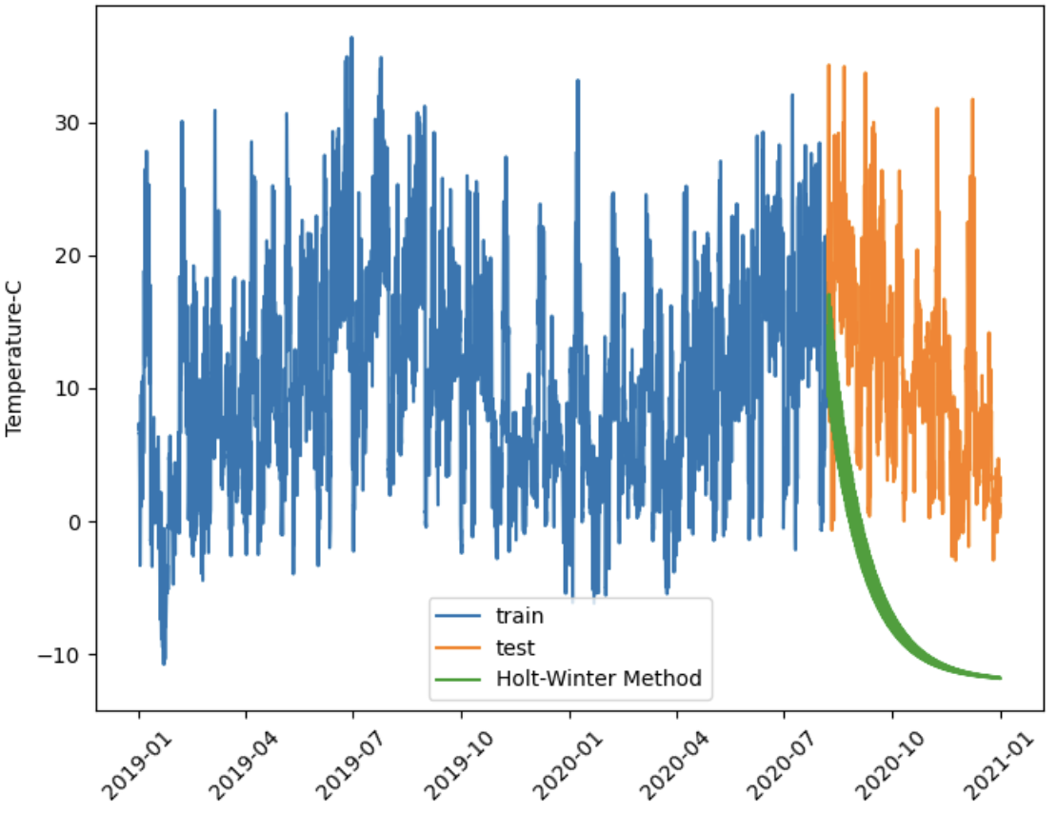
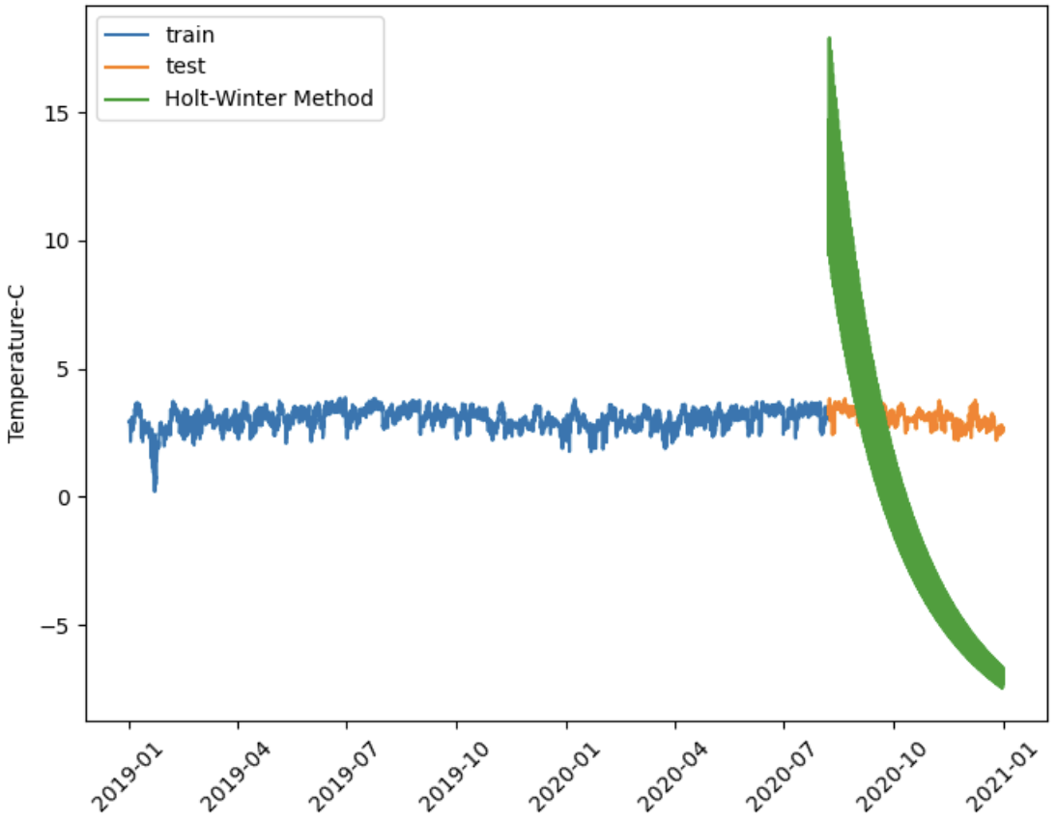
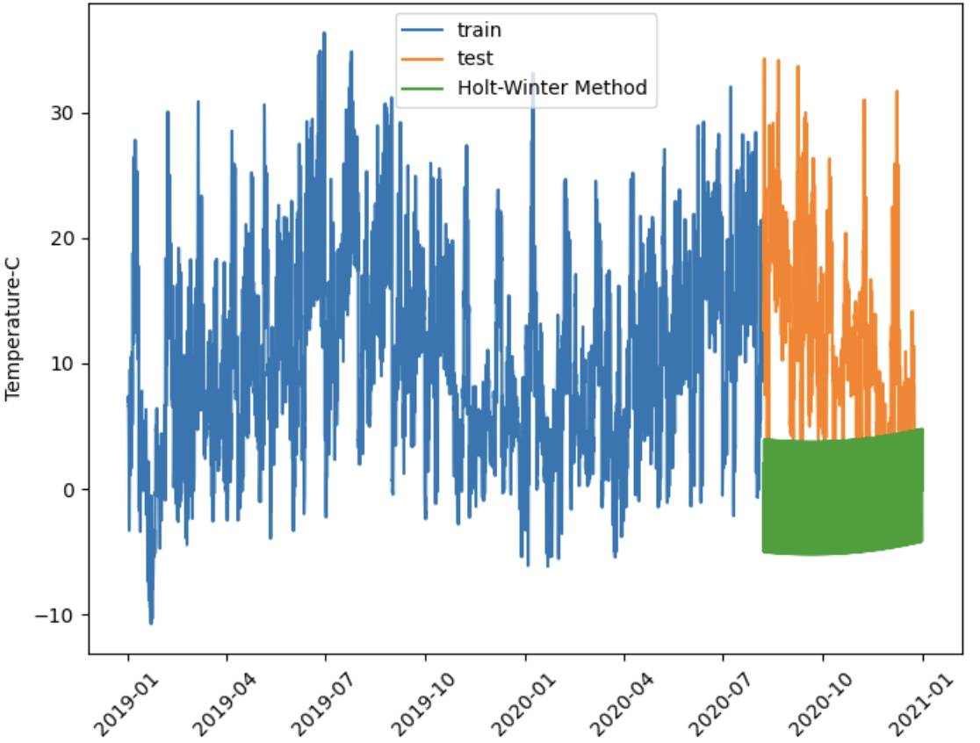
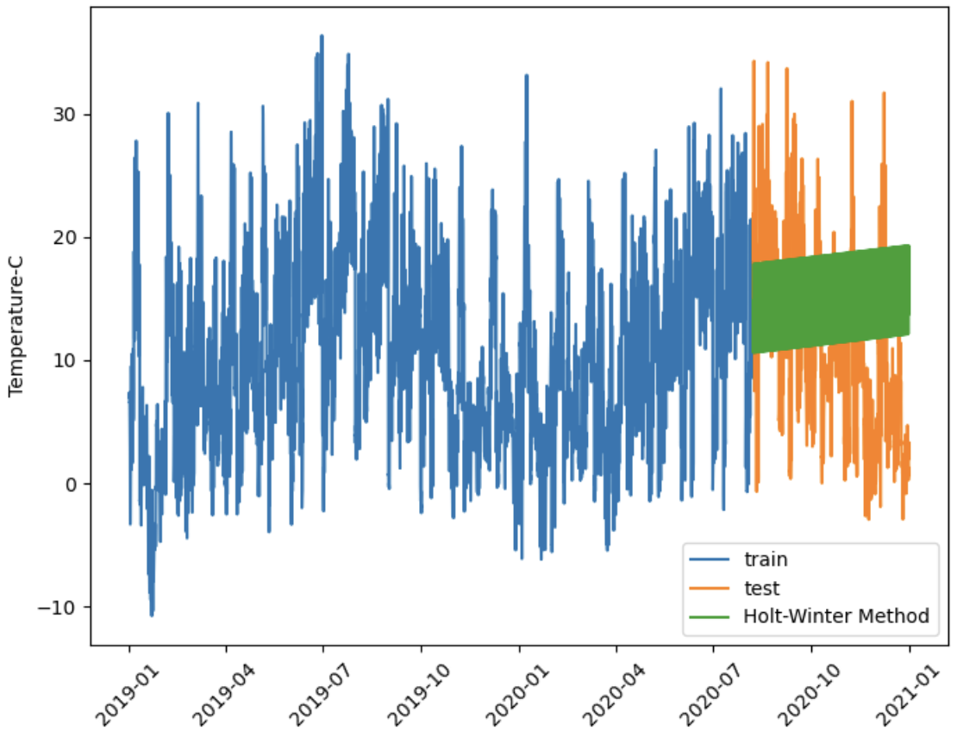
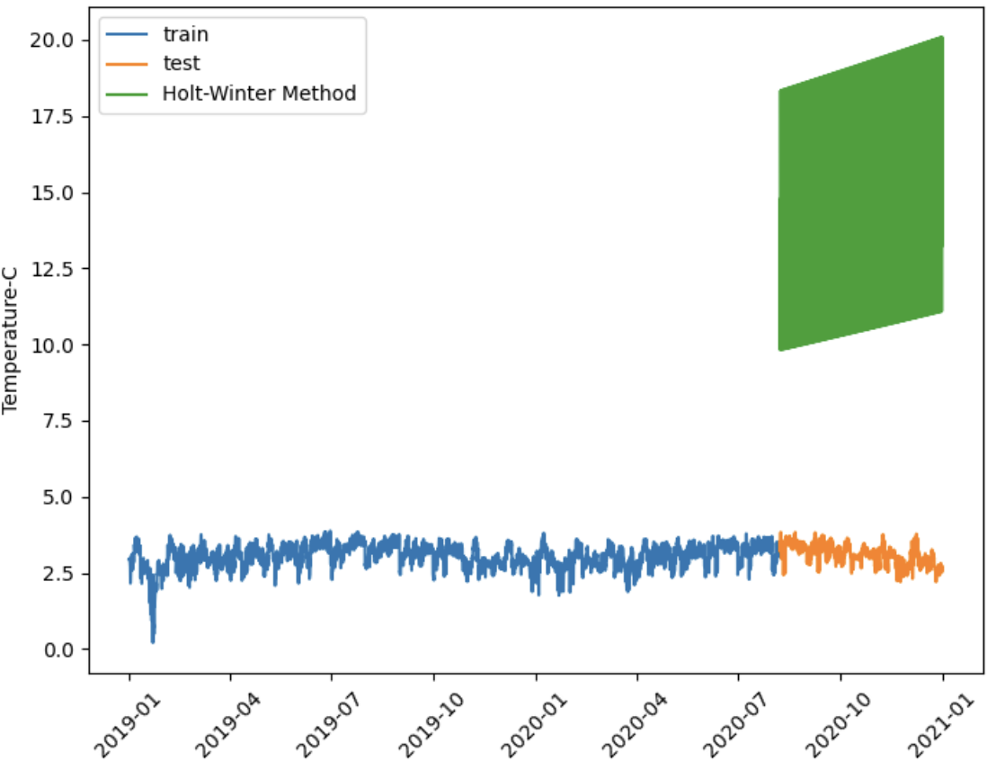
Raw(Mul)
Log(Mul)
1st diff (Add)
Raw(Add)
Log(Add)

Slide 11
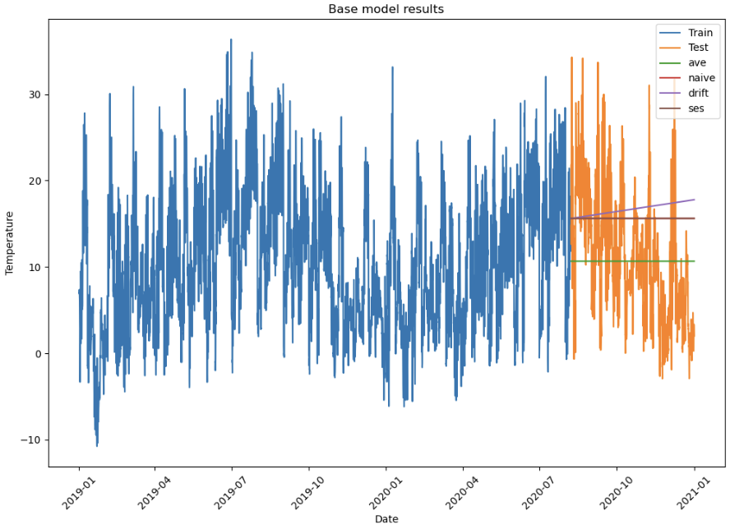
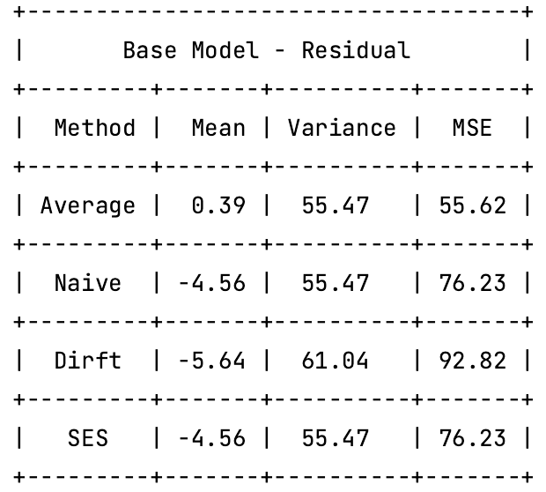

Slide 12
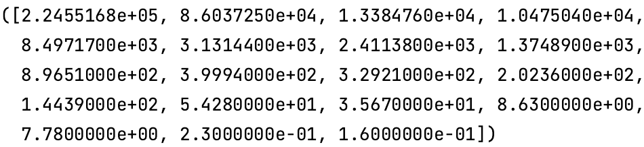
Singular values:
Condition number:
1,409,780.69

Slide 13
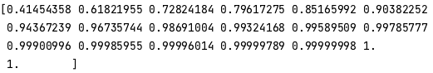
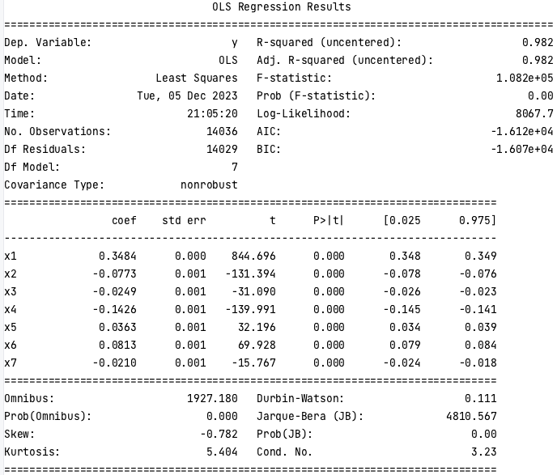
PCA

Slide 16
Remove | p-value | AIC | BIC | Adj_R2
\ | \ | (99,209.90) | (99,058.90) | 1.00
PAR | 0.79 | (99,211.90) | (99,068.40) | 1.00
Vapor_p_max | 0.33 | (99,212.90) | (99,077.00) | 1.00
CO2 | 0.09 | (99,212.00) | (99,083.60) | 1.00

Slide 17
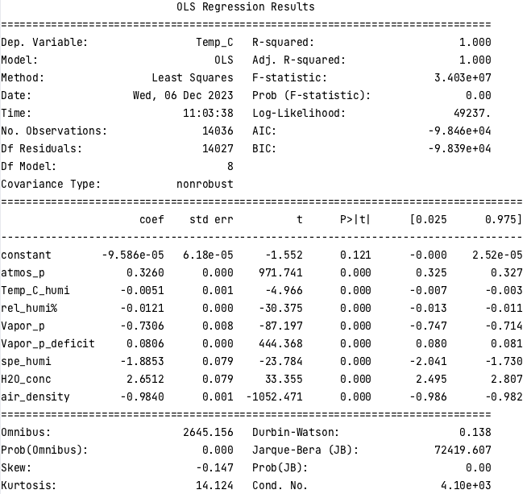
Backward stepwise regression

Slide 20
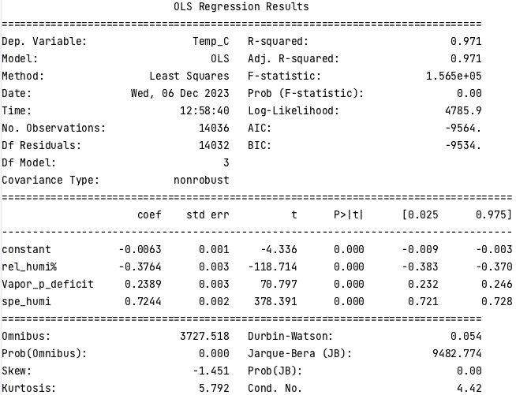
VIF

Slide 23
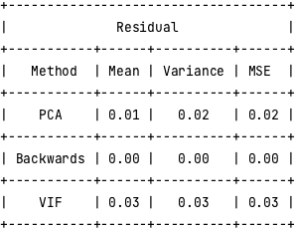

Slide 24
Raw
AR=1, MA=0

Slide 25
2 non-seasonal diff + 1 seasonal diff
MA = 1, AR = 0

